Slide 1
Analyzing Responses of Live Events Through Social Media Data A Project for Trent University, Canada
Presented By:
KEDAR DEODHAR
JANVI PATEL
PRERAK TRIVEDI

Slide 2
Problem Statement
Enabling the real time analysis using Spark to obtain visualized data format and sentiments of the data fetched from the social media websites (specially YouTube and twitter) using python scripting language to get an overview of the ideas perceived by the users in regard to the context of the video or tweet.

Slide 3

PROJECT OVERVIEW:
Streaming Twitter and YouTube data using APIs.
Sentiment Analysis of YouTube and Twitter Data.
Store data in MongoDB using PyMongo.
Visualization aggregation and machine learning in pyspark.

Slide 4
Technologies and Libraries
Libraries
Tweepy and Text Blob
youtube-api-client
PyMongo
PySpark
Database
MongoDB
Social Media Websites
Twitter
YouTube
Processing Software’s
Spark
Python3
Databricks
Amazon (AWS EC2 Instance)

Slide 5
Why use APIs for streaming?
Undoubtedly, the static file extensions (like CSV) are easy to use and store. Moreover, sharing these files is a lot easier as well.
We use APIs because every time we stream the data using the APIs, a new dataset is received.
In this world of changing trends, it is of no use if you work on a dataset that was extracted long back or is old. Moreover, the core idea of our project lied in the dynamic dataset which are susceptible to changes.
The streaming concept and dynamic data could only be satisfied by the APIs hence the use of YouTube and streaming Twitter APIs.

Slide 6
Data Collection and processing
The collection of Data is done using Tweepy and YouTube’s google API client whose support is extended to python for the connection and streaming the data.
Both these datasets collected form data lakes are stored in the form of a dictionary .
Firstly, we had created a database in Mongo DB and then using python scripting nano editor we have streamed the data by using YouTube and twitter API.

Slide 7
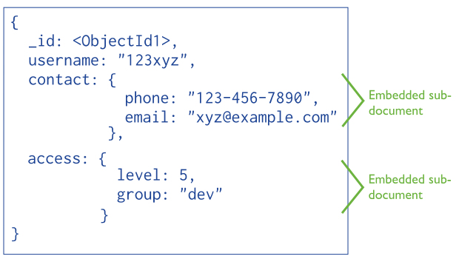
For the Twitter part, we fetched a few key elements from the response we got from Tweepy, like Tweet ID, text, location. The API took a hash tag as a search query input and returned an object consisting of details of tweets being posted.

Slide 8
TextBlob
Textblob is the library we used to perform sentiment analysis on the text of the tweets.
Textblob uses NLTK (Natural Language ToolKit) to not only understand the words individually but infer the meaning of the entire sentence with context.
Textblob returns two important characteristics of the supplied text data, Subjectivity and Polarity.
Using both of them gives a better idea about the emotion of the tweet writer while also considering the objectivity of the tweet. We attached these values

Slide 9
After retrieving these numbers for all tweets, we pushed polarity and subjectivity of each tweet in database as an object(in JSON format, since Mongo is a No SQL db) along with tweetID, text, name, created_at (time).
Below figure provides a glimpse of the twitter data that we uploaded to mongoDB which was around 100,000.

Slide 10
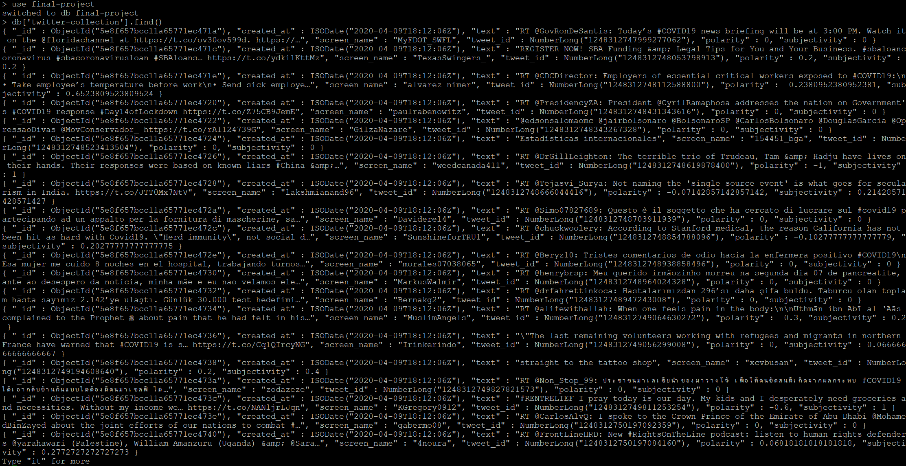
Twitter data

Slide 11
YouTube
For the YouTube part, we used the youtube search function provided by the API. This function takes the following inputs.
Search Query
Maximum number of videos
Order (to filter results, like relevance, newest, most viewed)
Location
We also had to supply our developer credentials which we had obtained on the google developer console.

Slide 12
This function returned a complex object which consisted of a lot of information about the video, including video details like its name, its statistics like likes, dislikes, comments, views and uploader details, to name a few.
The relevant parameters for us were Channel title, Video title, Number of views, likes, dislikes, comments.
After obtaining the data, we found some very basic numerical information about the results like average of the statistics, response rate (How many of the viewers like the video) and response quality (Positive/ Negative based on Likes to dislikes ratio).

Slide 13
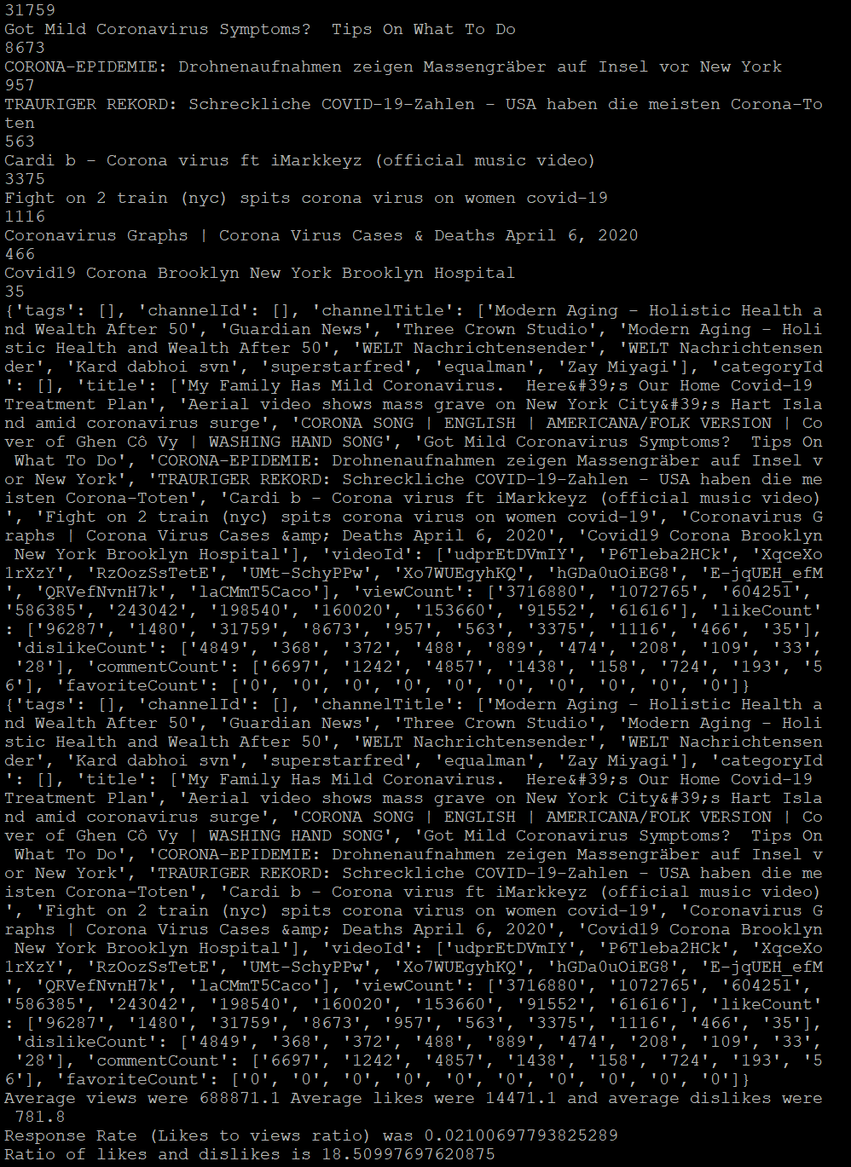

Slide 14
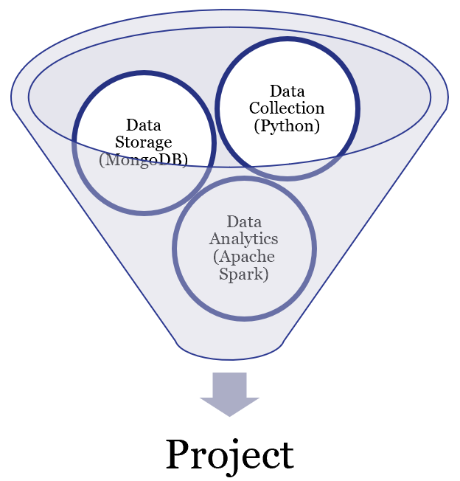
Data Analytics
Apache Spark can be considered as the sole technology that completely crushed most of the Big Data Analytics technologies that existed. The lectures conducted by the Professor pointed out two main advantages of the Apache Spark which did not let a single doubt arise in our mind about choosing this technology for the big data.
The first advantage is the speed of Spark because of its in-memory data engine and the other advantage is its ease of use for the users.

Slide 15
Furthermore, the support provided by the Apache Spark for the machine learning (MLib) and visualizations of the data from the SQL query is awesome. We have used a ready to use instance of Spark from the databricks so that we can have code as well as the output simultaneously.

Slide 16
